Slide 1

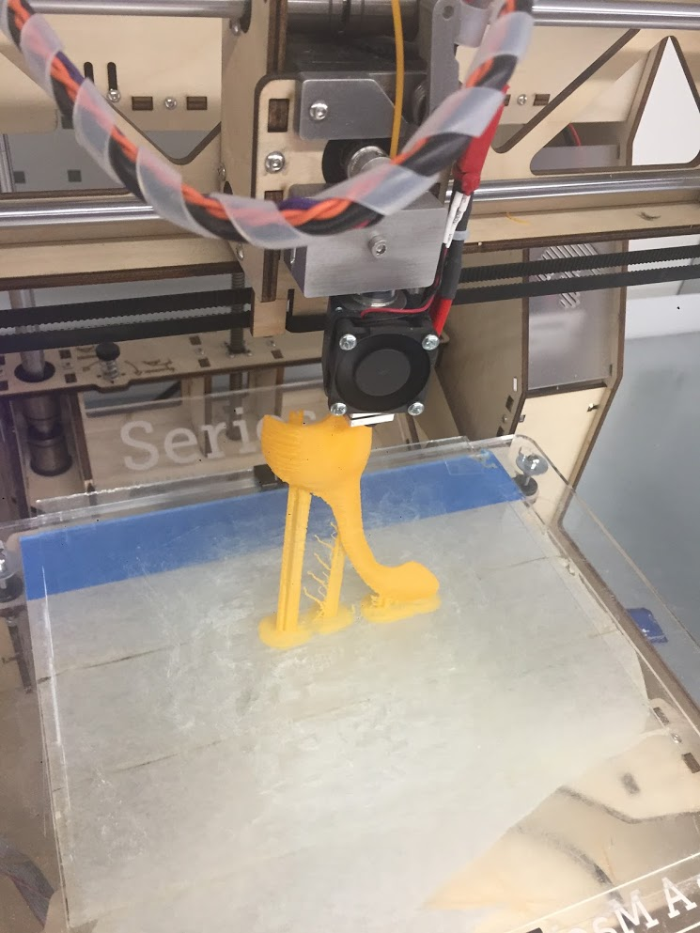
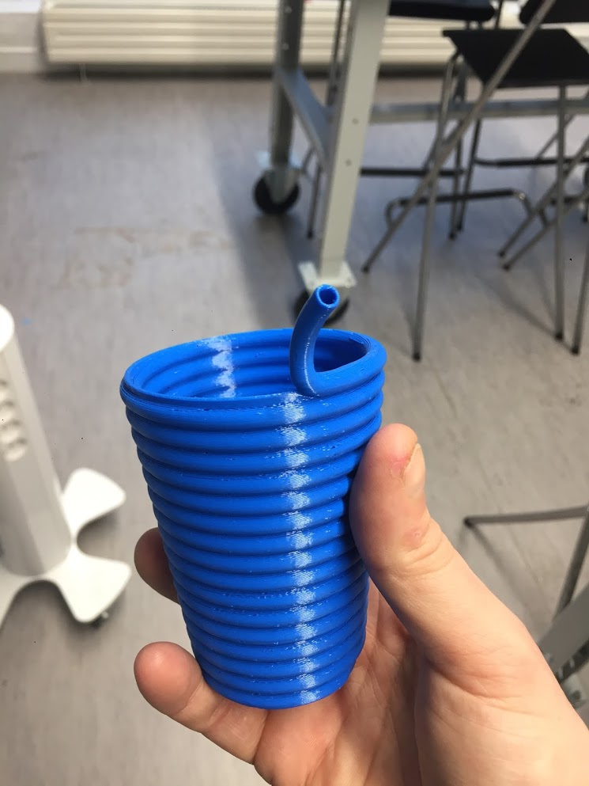
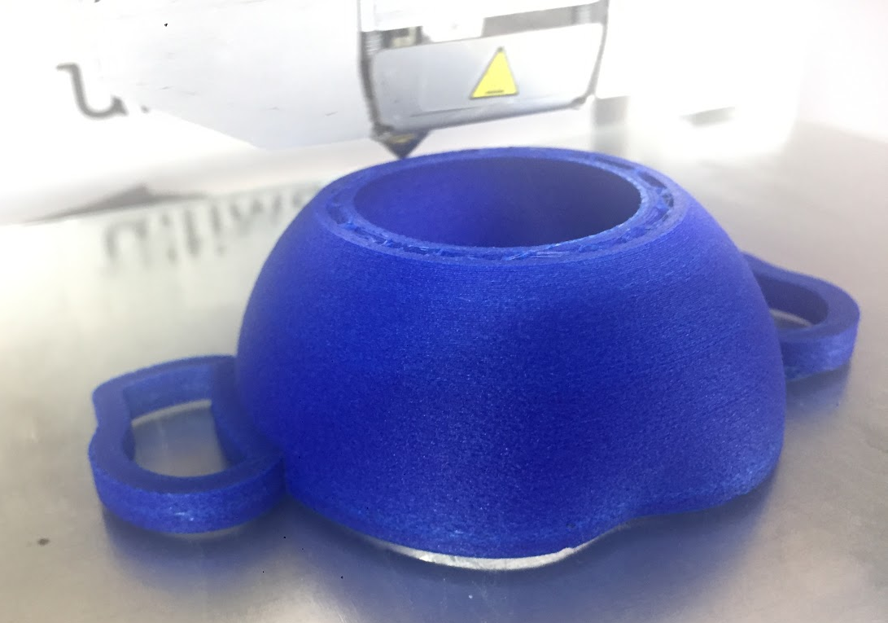
Westerdals
Produce functional prototype: Ice cream cup
jakob.a.nilsson@gmail.com

Slide 2

This week - Produce functional prototype
Final CAD tweaks - based on tests!
Print - problems & revisions
Design freeze! (Wednesday?)
Make drawings of the final design
Next week:
Pictures of people using your product
Documentation
Notes:
Will it print. User testing (if you want to be able to alter it, otherwise it isn’t testing its delivery)
Very limited time to test, redesign and reprint in this week!
Meaning if you test something in this week and don’t like it you will not have time to change it!

Slide 3
Last week with CAD and 3D print assistance
Cad support in classroom
Onsdag: 9:15-11:00
Focus is on drawings and improving your model based on print tests
Support in makerspace
Onsdag: 11:00-12:00
Torsdag: 9:15:-11:45. 12:15-13:45 (Milano møte 13:45)
Fredag: 9:15-12:00
Focus is on finding good settings and print directions for your print
There is no 3D help next week, which is the last week.
Get your questions now instead of later.

Slide 4
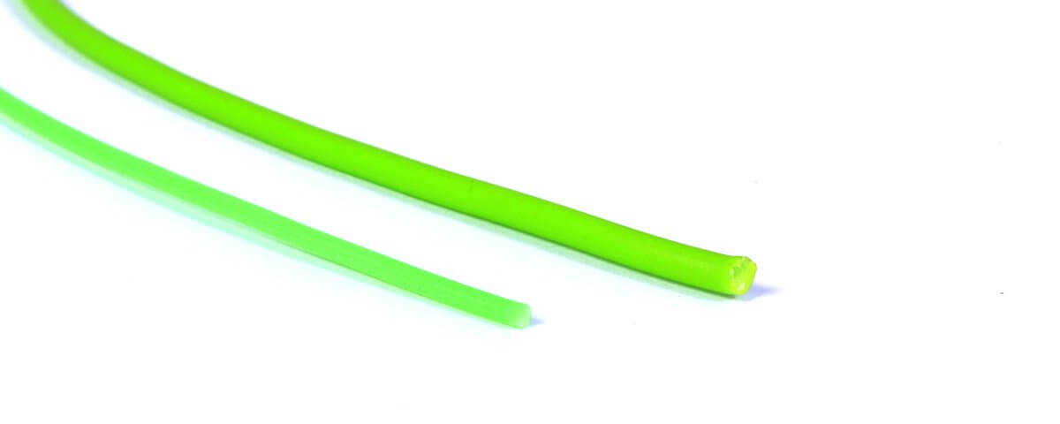
PLA Filament
Type A Machines S1 2013
1.75 mm Transparent
1.75 mm Rød
1.75 mm Sort
1.75 mm Orange (lys/transparant)
1.75 mm Lysblå (Almost out!)
Ultimaker 2+ Extended
2.85 mm Sølv
2.85 mm Hvit
2.85 mm Blå (matte med fibrer)
2.85 mm Wood natural (med fibrer)
2.85 mm Grøn ( Transparant) (Almost out!)
2.85 mm Dypblå (Almost out!)
See the colors here

Slide 5
Test prints & Cura
Before final print, answer these questions:
Which print direction?
Use support? (4 min video covering both)
Try “touching buildplate” under custom settings
Will it print nicely?
Preview with “layer view”
Which filament?
The finish will vary!
Test with parts of your model! Or at least a downscaled version.
To make a part for test printing:
Save as new file, name “test part”, cut away everything you don’t want in your test
Notes:
Show test?

Slide 6
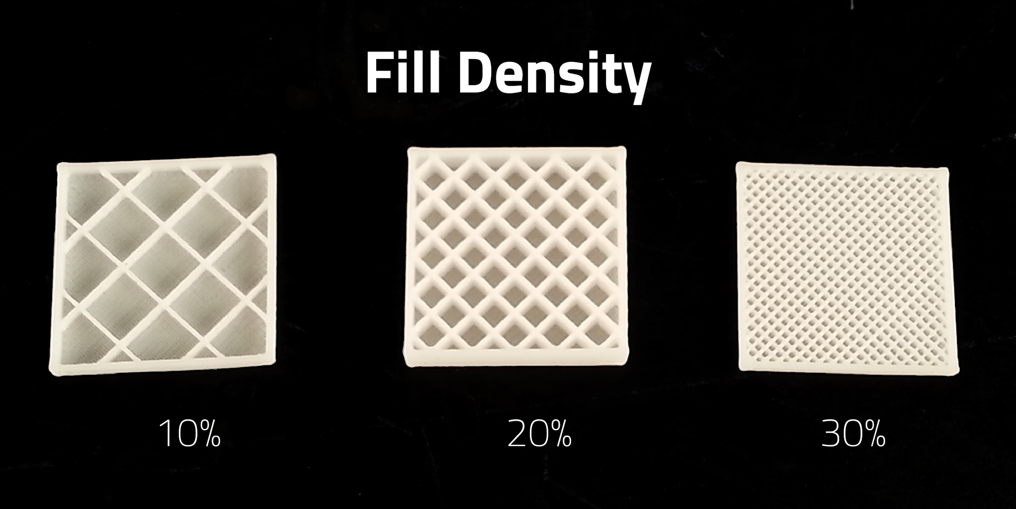
Final prints
Before you attempt final printing :
Have you tested first?
Check the expected print time:
Do you really need less than 0,15 mm layer thickness?
Do you really need more than 15% infill?

Slide 7
Design freeze (target wednesday?)
When you have a good final print, stop changing your models. The design is frozen.
Make drawings of the final design
“1 teknisk tegning/ skjemategning med målsatt plan og oppriss, samt et isometrisk perspektiv og en detalj fra objektet”
Pictures of people using your product
“1 godt og beskrivende miljø perspektiv/ ilusstrasjon av objektet (isbegeret) brukt av målgruppen under 17.mai ( da svært gjerne med mennesker, som tar i bruk isbegeret.)”
Examenstext

Slide 8
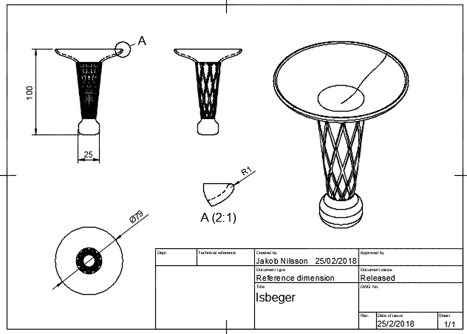
Reference drawing
Link to the drawing in fusion360
Also on itslearning as PDF
“1 teknisk tegning/ skjemategning med målsatt plan og oppriss, samt et isometrisk perspektiv og en detalj fra objektet”

Slide 9
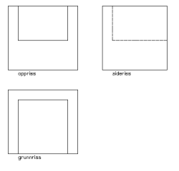
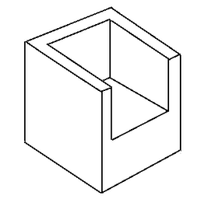
Technical drawings
Orthagonal views
Isometric view
Dimensions, show the size.
Title block, fill in info
Detail view
Included in Fusion360
Reference in norwegian
Notes:
iso is a specific view
Orthagonal is no vanishing point
“1 teknisk tegning/ skjemategning med målsatt plan og oppriss, samt et isometrisk perspektiv og en detalj fra objektet”
http://www.hobbykjelleren.net/formgivingsfag/arbeidstegning.htm

Slide 10
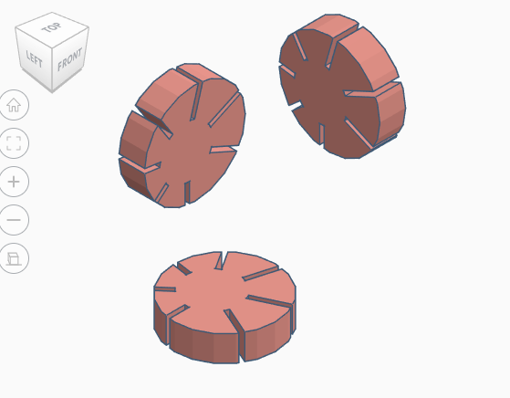
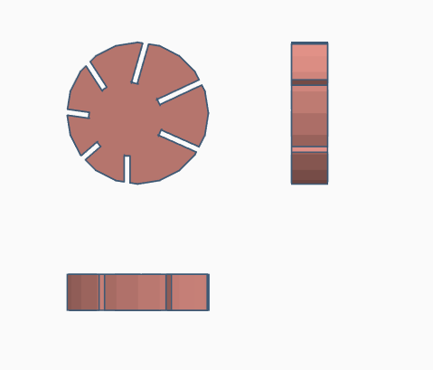
Tinkercad screenshot method
Press corner for ISO
Add manually
Ø20
5
Switch to Orthographic

Slide 11
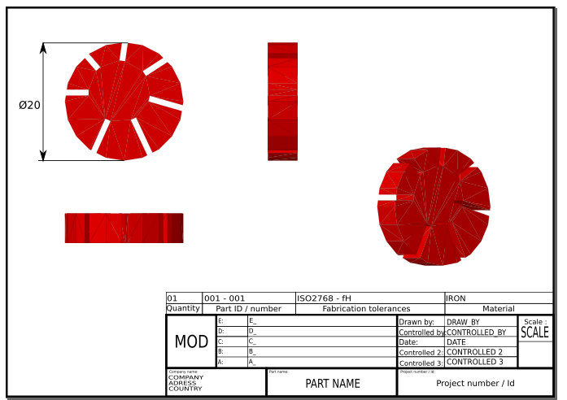
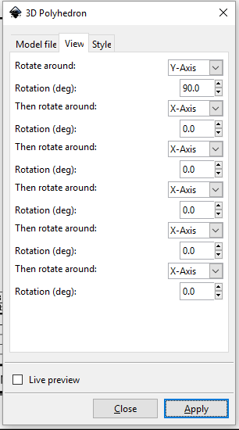
Tinkercad + Inkscape 3D model method
Inkscape Importing .obj files to inkscape Svg drawing template
Use!

Slide 12
Questions?
CAD
Printing
Drawings

Slide 13
Last week with CAD and 3D print assistance
Cad support in classroom
Onsdag: 9:15-11:00
Focus is on drawings and improving your model based on print tests
Support in makerspace
Onsdag: 11:00-12:00
Torsdag: 9:15:-11:45 12:15-13:45
Fredag: 9:15-12:00
Focus is on finding good settings and print directions for your print
There is no 3D help next week, which is the last week.
Get your questions now instead of later.

Slide 14
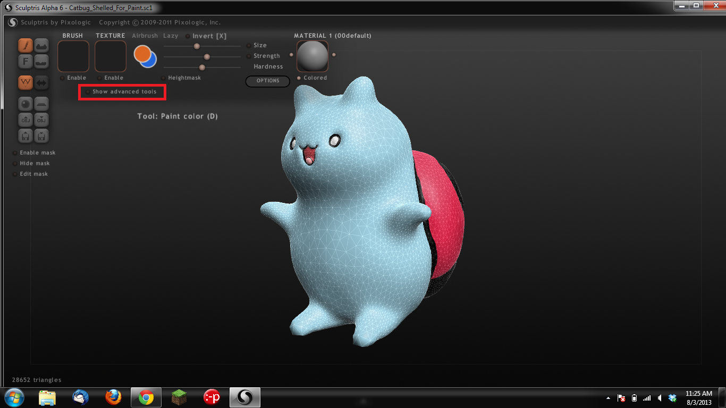
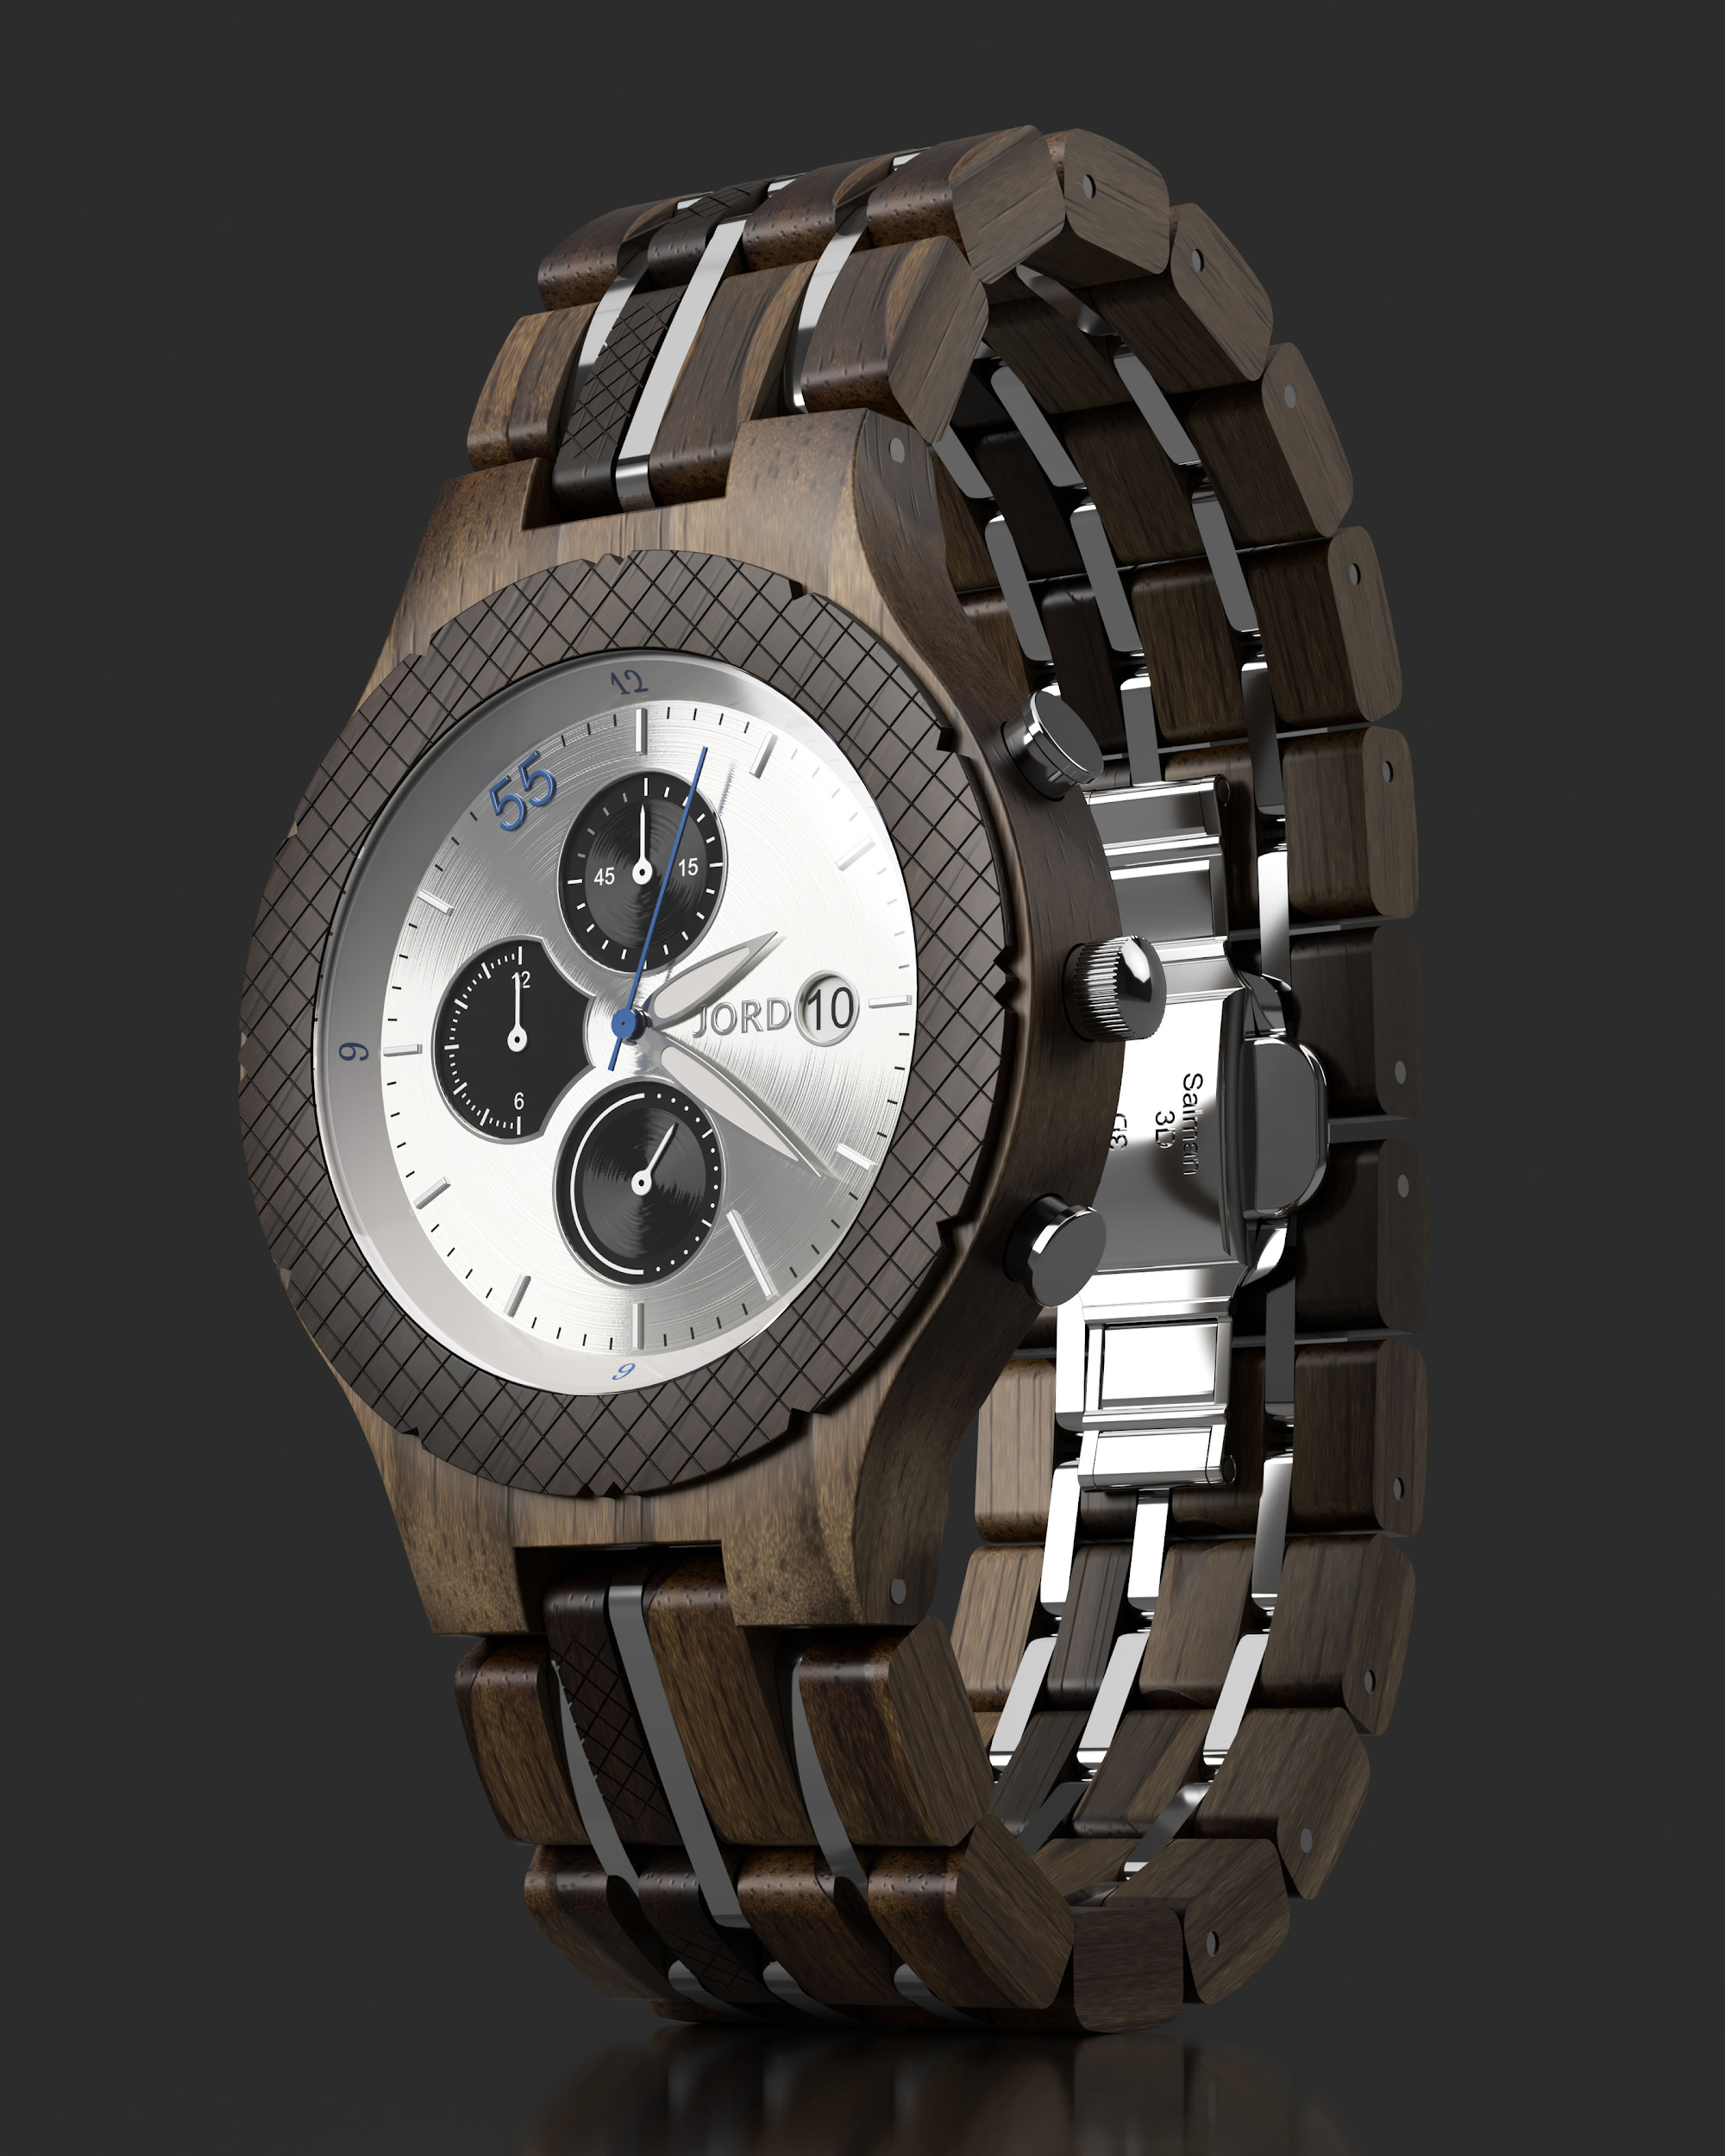
Bonus features
If you have time try:
Sculptris + TinkerCAD
Fusion360: Render and animations workspaces

Slide 15
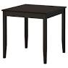
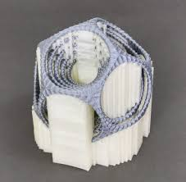
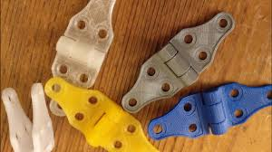
Special features, if you want them!
Moving parts
Can be printed as one part (like this 1 print elephant with moving legs)
Can be snapped together (like these car wheels)
Avoid complex manual assembly, especially using fasteners glue etc.
Support material
Is OK! But you will have to remove it yourself!
Worse surface finish
In batch production soluble support would be used (Ultimaker PVA example)
Consider if rotating the print solves the problem or if you can design around it?

